Slide 1
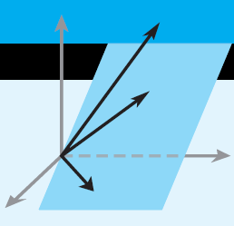
Elementary Linear Algebra
.
Chapter 2
Determinants
Notes:
*

Slide 2
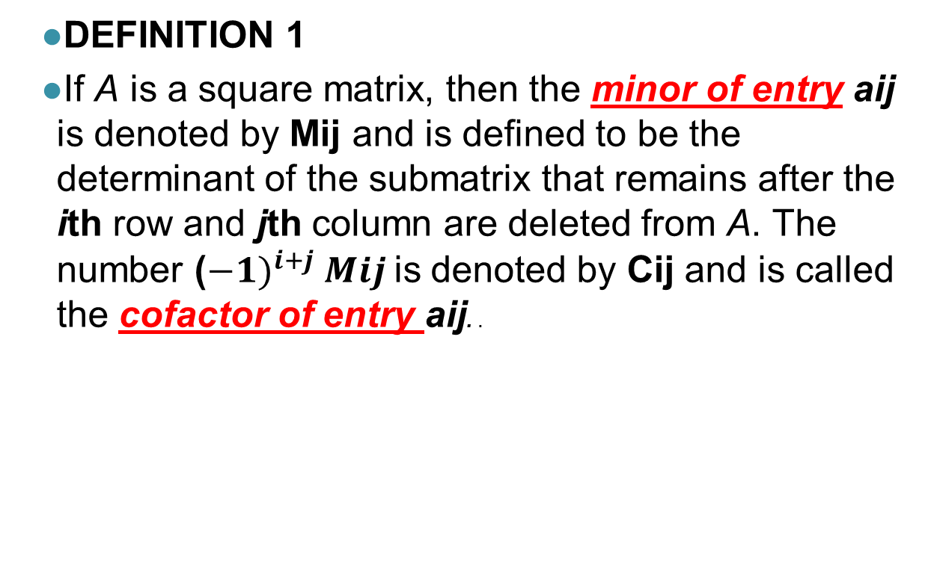
2.1 Determinants by Cofactor Expansion
DEFINITION 1
If A is a square matrix, then the minor of entry aij is denoted by Mij and is defined to be the determinant of the submatrix that remains after the ith row and jth column are deleted from A. The number (${−1)}^{i+j} Mij$is denoted by Cij and is called the cofactor of entry aij. .

Slide 3
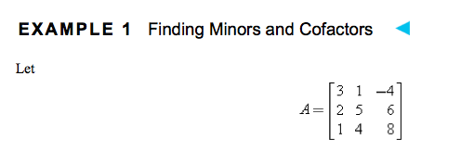
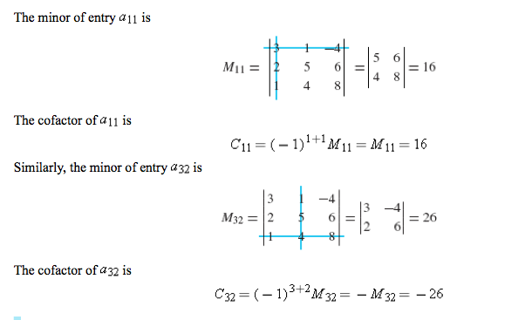

Slide 4
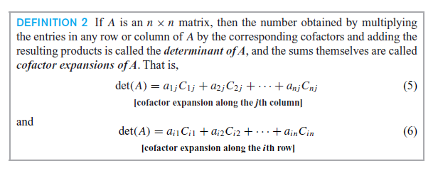
Notes:
*

Slide 5
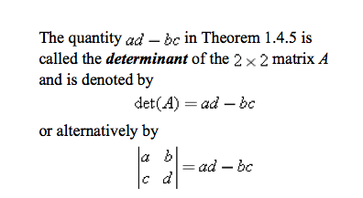
Determinant of 2 x 2 Matrix
Notes:
*

Slide 6
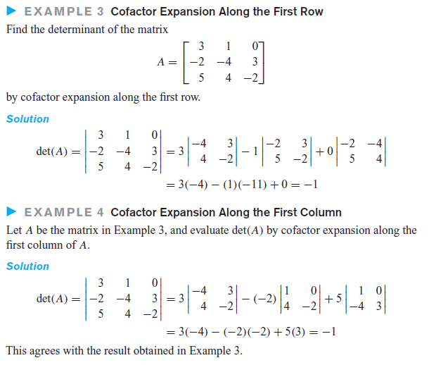
Notes:
*

Slide 7
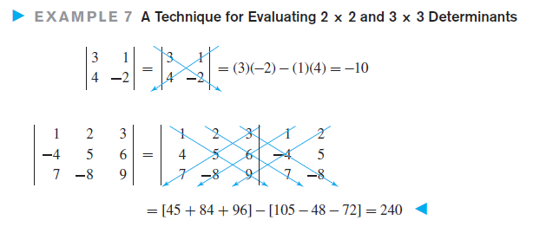
A technique for determinants of 2x2 and 3x3 matrices only
Notes:
*

Slide 8

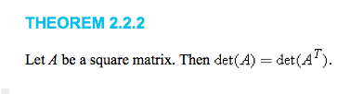
2.2 Evaluating Determinants by Row Reduction

Slide 9
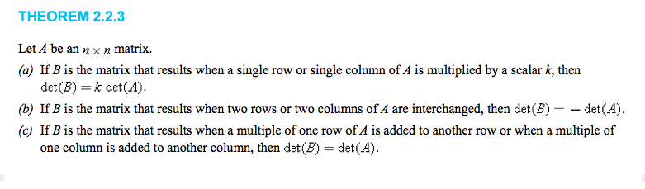

Slide 10
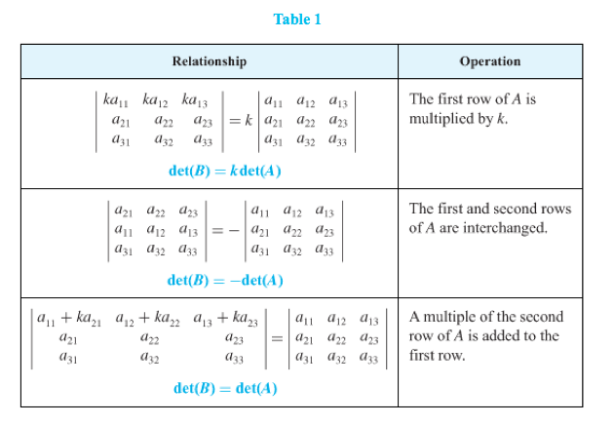

Slide 11
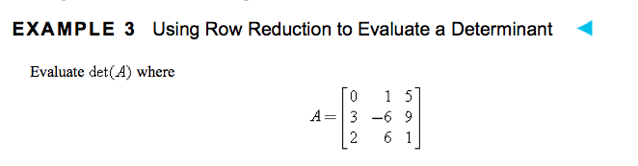
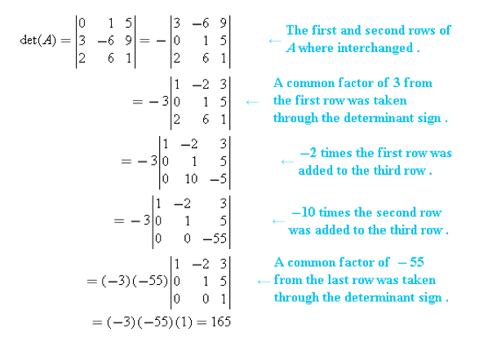

Slide 12
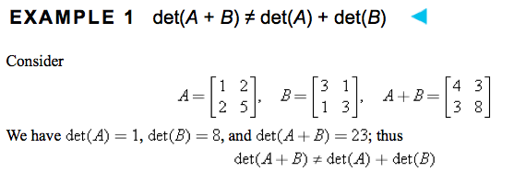
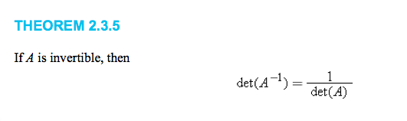

Slide 13
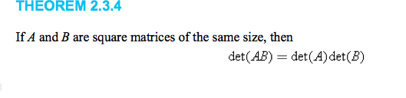
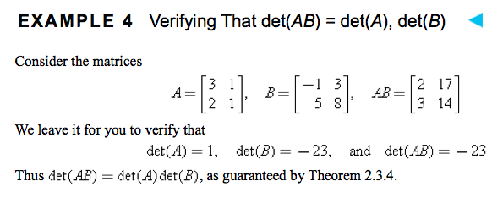

Slide 14
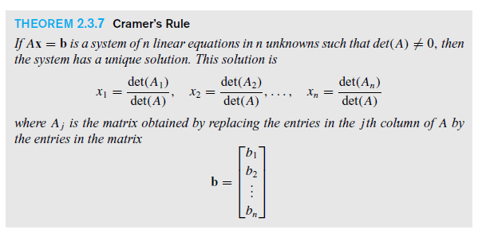
2.3 Properties of Determinants; Cramer’s Rule
Notes:
*

Slide 15
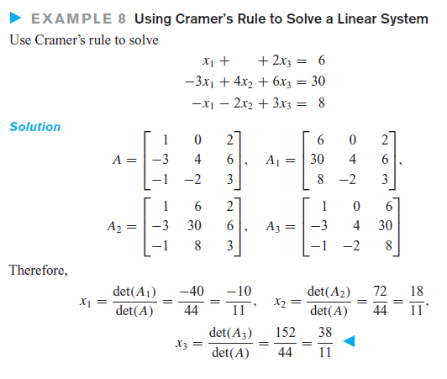
Notes:
*

